Slide 1
Cascade Cup
Round 3
EDA Report
Team: Data Gambit

Slide 2
Introduction
Absenteeism is a habitual pattern of absence from a duty or obligation without good reason. Generally, absenteeism is unplanned absences.
If a workplace exhibits high degree of absenteeism there is a problem.
It has been viewed as an indicator of poor individual performance, as well as a breach of an implicit contract between employee and employer.

Slide 3
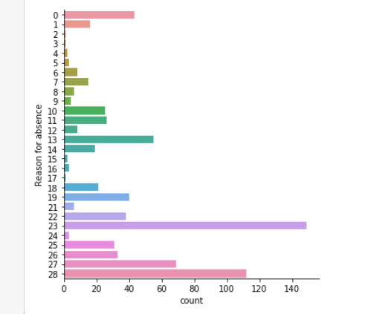
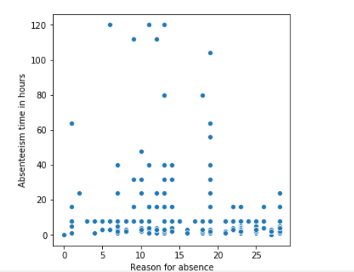
Visaulize Original Dataset
Here also, only some reasons cause large number of Absenteeism time.
In this figure we can see only some reasons are very common like 23,28,27 and 13, and rest are rare.

Slide 4
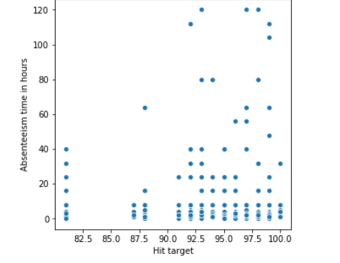
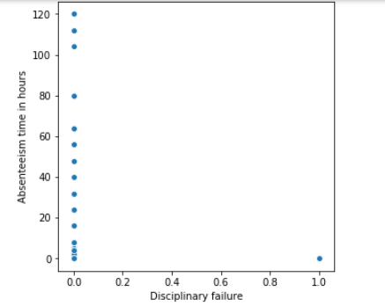
Visaulize Original Dataset
Employees with higher hit target have higher number of Absenteeism hours.
Employees with Disciplinary failure never have Absenteeism

Slide 5
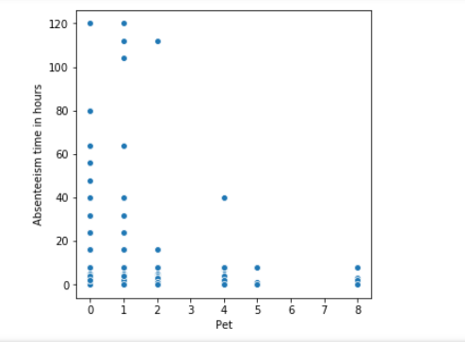
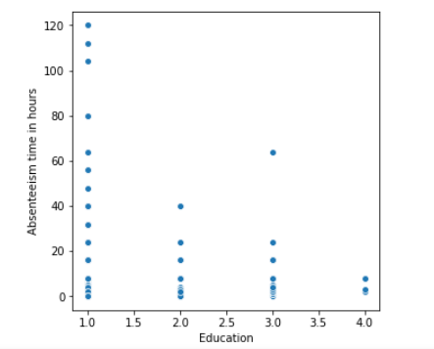
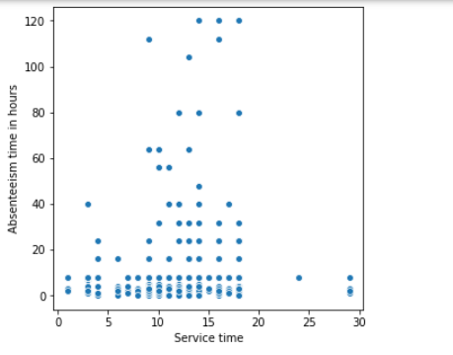
Visaulize Original Dataset
Employees with more pets have less Absenteeism hours.
Employees having doctorate are more serious towards work.
High school passed employees are least serious.
Employees with either low or high service time don’t have high Absenteeism .

Slide 6
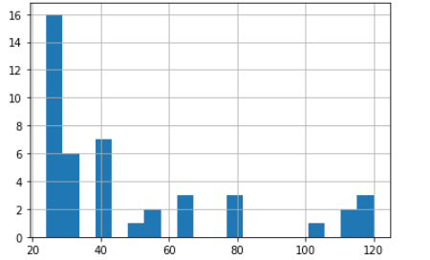
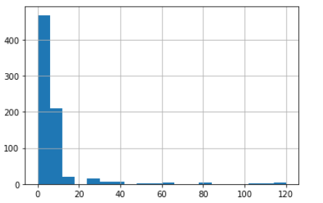
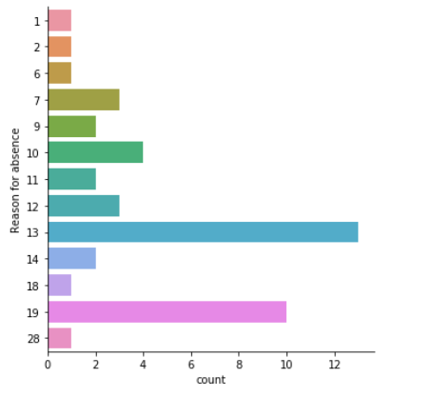
Modifying the Dataset
We get this
We are only left with these reasons for absenteeism
This is histogram of distribution of Absenteeism hours. Lets drop the entries of those whose Absenteeism is less than 20hrs

Slide 7
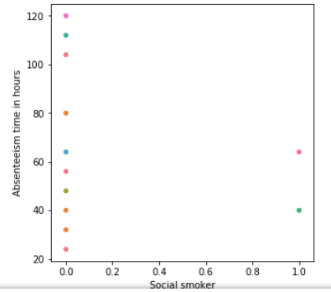
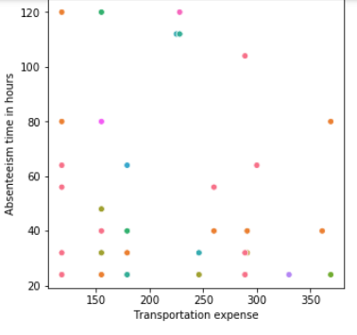
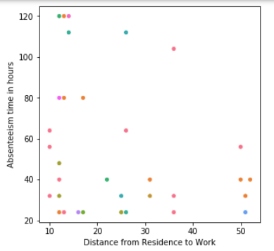
Visaulize Modified Dataset
People who smoke have less Absenteeism hours. (drinking doesn’t give any good coorelation.
People who live near the workplace and have less transportation expenses have higher Absenteeism.

Slide 8
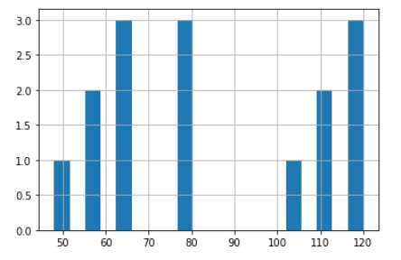
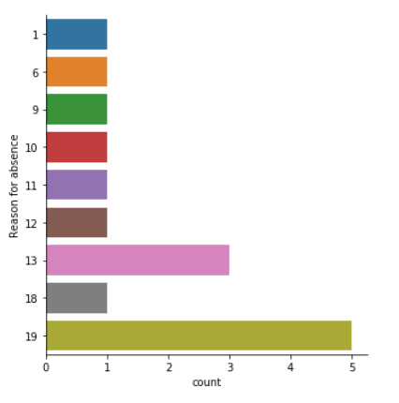
Modifying the Dataset Again
We get this
We are only left with these reasons for absenteeism. These are the major reasons, company should work on
From this(previously discussed histogram), we would like to analyze only those, whose absenteeism is >40

Slide 9
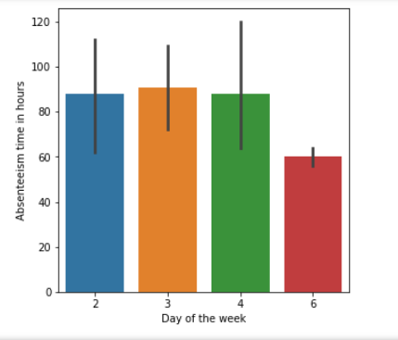
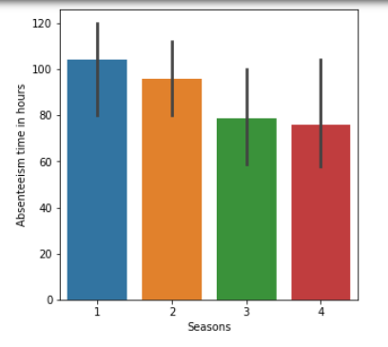
Visaulize Modified Dataset
Significant trends (other than what we discussed earlier) are seasons and days of week. Employees generally have more absentee in starting of week (may be procrastination after weekend), and the season trend can be seen above.

Slide 10
Hence we conclude our
observations
Thank You

